Slide 1
Mach-zehnder modulators
Theory and Application
Vince Baker
Drexel University

Slide 2



Mach-zehnder modulators
Electro-optic modulators that impress a low-frequency (0-100 GHz) as an amplitude modulation on an optical carrier
Commonly used in telecommunications industry for wideband data transfer over optical fiber
Works on electro-optic effect: an applied field causes a change in the index of refraction of a material
Input signal
$$A=e^{i(ωt+φ)}$$
Source laser
$$C=e^{iωt}(1+e^{iφ})$$
Electro-optic material
Amplitude-modulated output signal
$$B=e^{iωt}$$

Slide 3
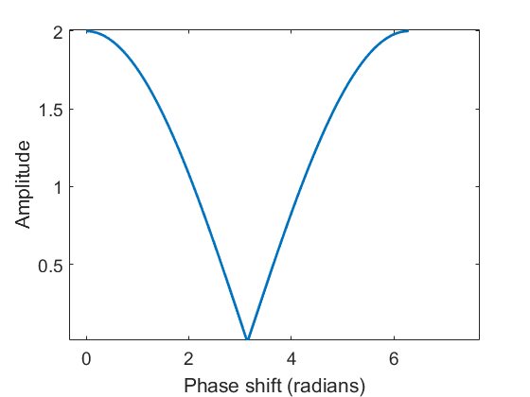

Modulated data
Amplitude is the absolute value of $\left(1+e^{iφ}\right)=\sqrt{2+2\cos{φ}}$
Nonlinear mapping from source data to amplitude modulation
Typically biased at quadrature point ($π/2$)and driven in small-signal regime for best linearity
Operating region

Slide 4

Electro-optic effect (linear)
Pockels effect: index of refraction is linear in electric field
Index of refraction/relative permittivity related to susceptibility of material
Total phase shift is a function of index of refraction and length of path
Various tradeoffs between L, d and V determine operating parameters
L
d
E = V/d
V
$$C=εA/d$$

Slide 5

Modulator types
Discrete: LiNbO3 is the dominant material, >100 GHz bandwidth possible
Integrated: demonstrated on silicon with lower bandwidth and performance (~10 GHz)
Discrete modulator from EOSpace
“High speed silicon Mach-Zehnder modulator”, L. Liao, D. Samara-Rubio, M. Morse, A. Liu, D. Hodge, Optics Express Vol. 13 No. 8, 18 April 2005

Slide 6
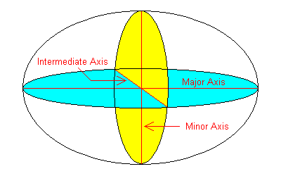
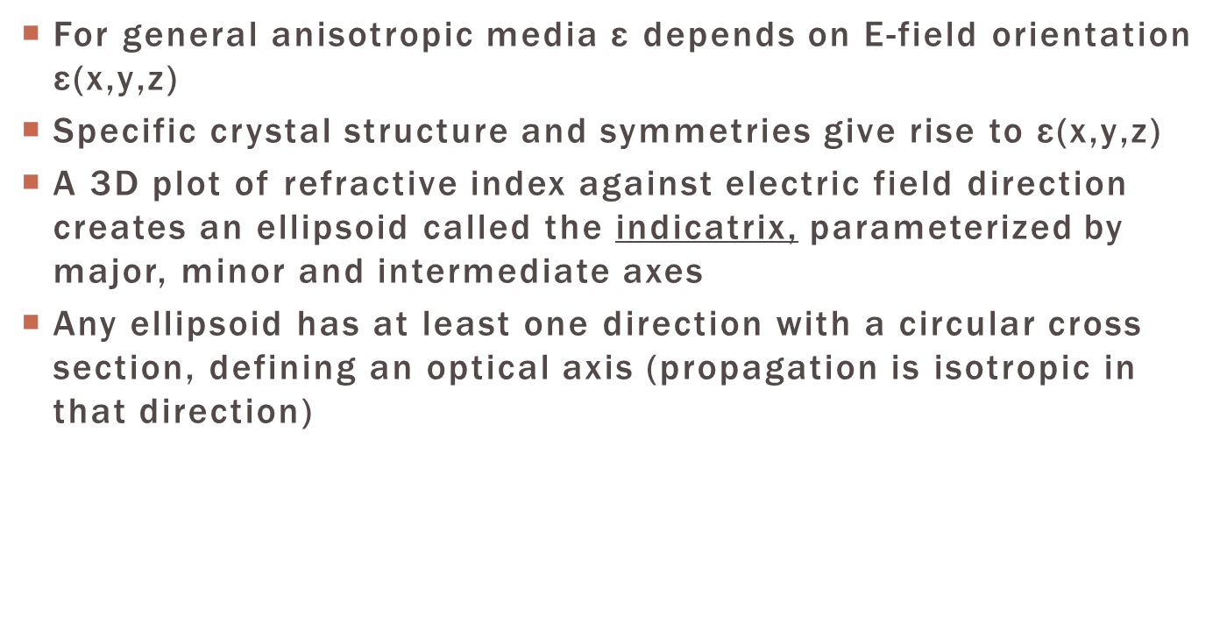
indicatrix
For general anisotropic media ε depends on E-field orientation $\text{ε}\text{(}\text{x}\text{,}\text{y}\text{,}\text{z}\text{)}$
Specific crystal structure and symmetries give rise to $\text{ε}\text{(}\text{x}\text{,}\text{y}\text{,}\text{z}\text{)}$
A 3D plot of refractive index against electric field direction creates an ellipsoid called the indicatrix, parameterized by major, minor and intermediate axes
Any ellipsoid has at least one direction with a circular cross section, defining an optical axis (propagation is isotropic in that direction)

Slide 7
Indicatrix
Electro-optic effect described by the electro-optic tensor:
Applied electric field changes the indicatrix shape

Slide 8
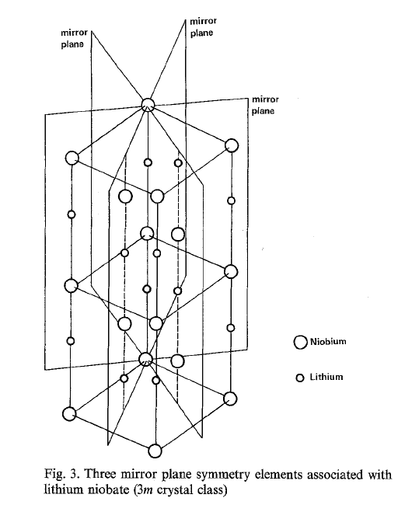
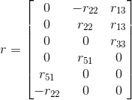
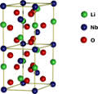
Lithium niobate structure
Lacks inversion symmetry (not centrally symmetric), otherwise the field due to nearby molecules would be 0 (Jackson pp 160-161)
Symmetry class 3M (three-fold rotational symmetry) leads to electro-optic tensor of the form:

Slide 9
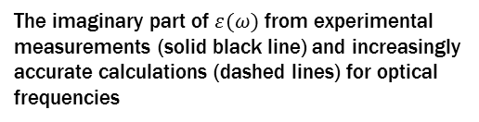
Determining electro-optic properties of materials
Material characterization is largely experimental
Some recent work using density functional theory to determine band structure and optical properties
The imaginary part of $ε(ω)$ from experimental measurements (solid black line) and increasingly accurate calculations (dashed lines) for optical frequencies
“Linear and Nonlinear Optical Response of LiNbO3 Calculated From First Principles”, A. Riefer, S. Sanna, A. Gavrilenko, W. Schmidt, IEEE TRANSACTIONS ON ULTRASONICS, FERROELECTRICS, AND FREQUENCY CONTROL, VOL. 59, NO. 9, SEPTEMBER 2012

